Slide 1


Slide 2
Introduction

Slide 3
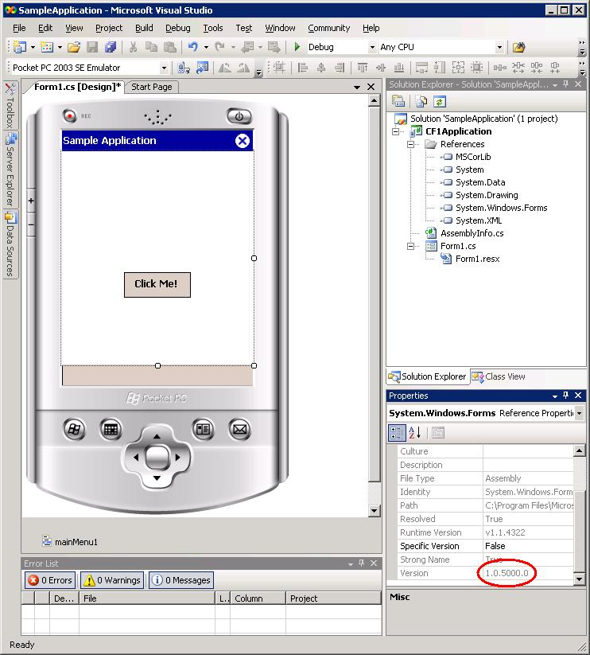


Slide 4
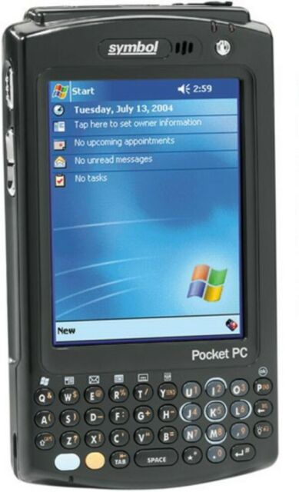

Slide 5

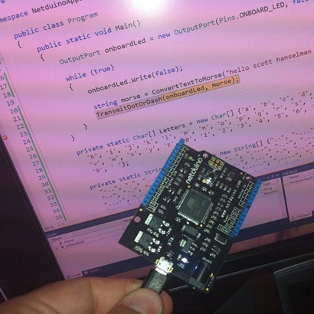
Notes:
2007 release

Slide 6

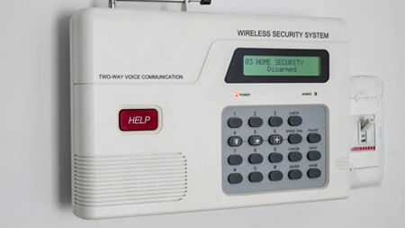

Slide 7
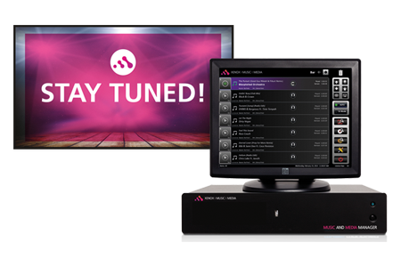

Slide 8
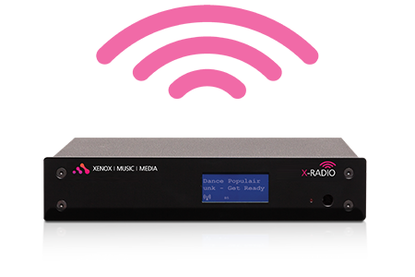

Slide 9
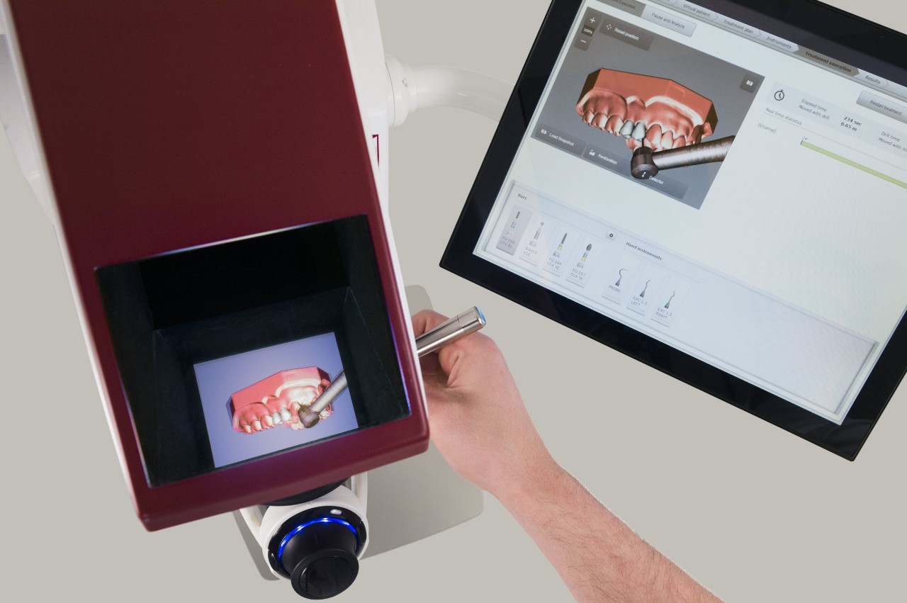

Slide 10


Slide 11


Slide 12
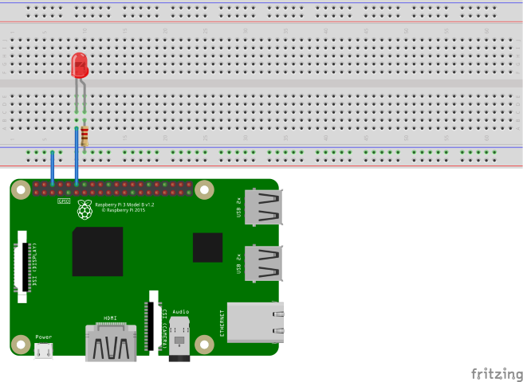

Slide 14

System.Device.Gpio
System.Device.Gpio supports various protocols for interacting with low-level hardware pins to control devices.
These include:
General-purpose I/O (GPIO)
Inter-Integrated Circuit (I2C)
Serial Peripheral Interface (SPI)
Pulse Width Modulation (PWM)
Serial port

Slide 15
Iot.Device.Bindings
https://github.com/dotnet/iot/blob/main/src/devices/README.md

Slide 16
OS
Tweak boot time
Clean/remove unneccessary
Recompile kernel
Patterns
Object pooling
Interop
DBus
Running
Containers?
SystemD
Compiling linking etc
Dotnet 6 improvements

Slide 17


Slide 18
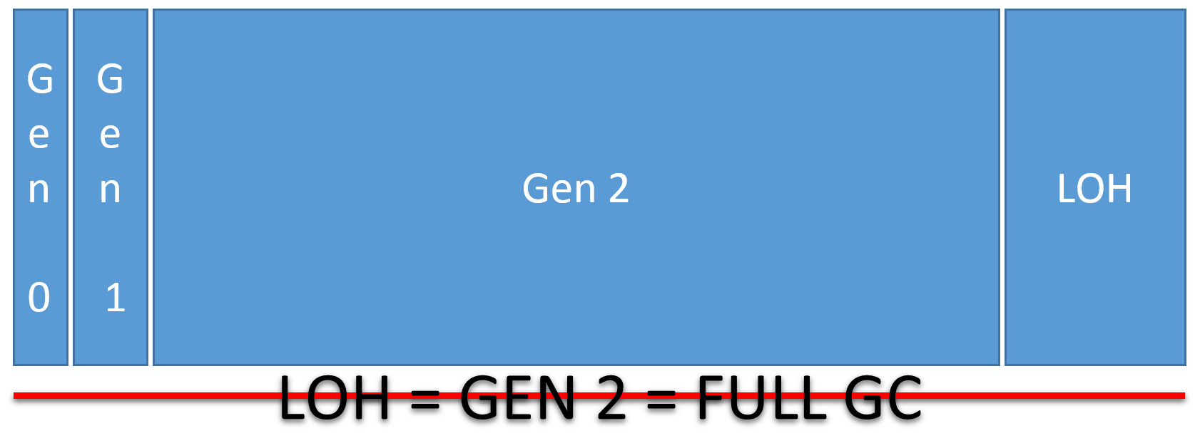
Memory & GC

Slide 19
Object Pooling
Preallocating objects
When?
Expensive to allocate/initialize
Represent some limited resource
Used predictably and frequently
Example: ThreadPool
Lowering GC pressure

Slide 20
Microsoft .Extensions .ObjectPool package
ObjectPool<T>
Instantiating a pool.
Registering a pool in Dependency injection (DI) as an instance.
Registering the ObjectPoolProvider<> in DI and using it as a factory.
PooledObjectPolicy<T>
Notes:
<PropertyGroup> <ServerGarbageCollection>true</ServerGarbageCollection> </PropertyGroup>
Runtimeconfig.json
ObjectPool<T> the basic object pool abstraction. Used to get and return objects.
PooledObjectPolicy<T> implement this to customize how an object is created and how it is reset when returned to the pool. This can be passed into an object pool that you construct directly.... OR
The ObjectPool can be used in an app in multiple ways:
Instantiating a pool.
Registering a pool in Dependency injection (DI) as an instance.
Registering the ObjectPoolProvider<> in DI and using it as a factory.

Slide 21

Building & publishing
Self-contained builds
Trimming
Building for different processor architectures
Ready-to-Run (AOT) builds

Slide 22
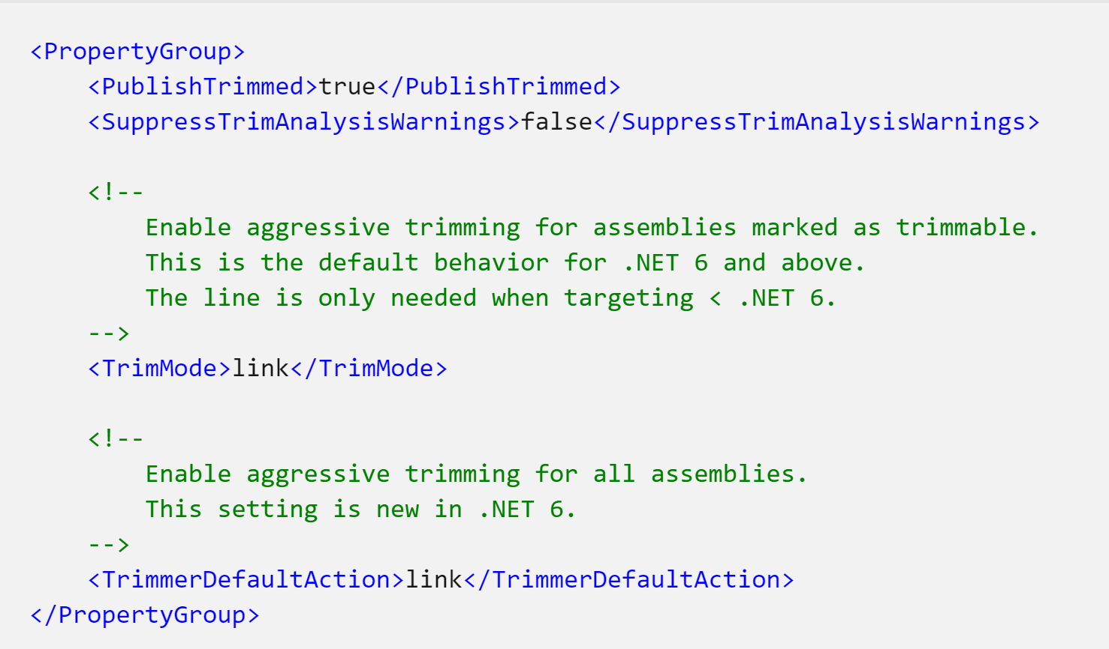

Slide 23

Running on the device
Docker
Systemd

Slide 24


